Slide 1

Graded Resumption
of
Delhi Metro Services

Slide 2

Graded Resumption of Delhi Metro Services
The resumption of services would be done geographically (i.e. Linewise) and temporally (i.e. revenue opening hours wise) in three stages.
STAGE-1
    Revenue services would be from 0700 hrs to 1100 hrs in morning and 1600 hrs to 2000 hrs in evening.
Phase-I
  From 7th Sept 2020 onwards.
  Line 2 including RMGL would be made operational.
Phase-II
  From 9th Sept 2020 onwards.
  Line 3,4 & 7 would also be made operational.
Phase-III
  From 10th Sept 2020 onwards.
  Line 1,5 & 6 would also be made operational.

Slide 3
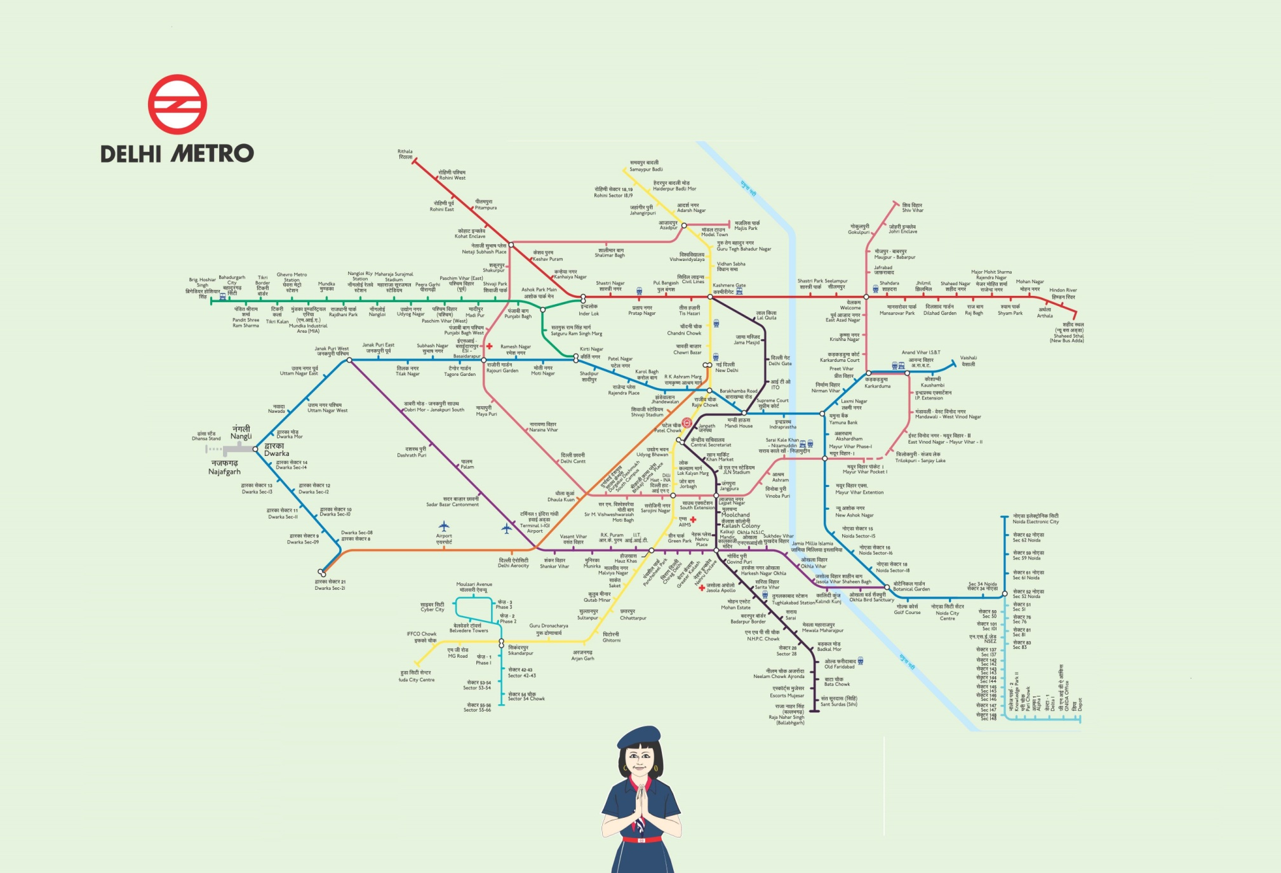
Graded Resumption of Delhi Metro Services
STAGE-1 (Phase-I)
  From 7th Sept 2020 onwards.
  Line 2 including RMGL

Slide 4
Graded Resumption of Delhi Metro Services
STAGE-1 (Phase-II)
  From 9th Sept 2020 onwards.
  Line 3, 4 & 7

Slide 5
Graded Resumption of Delhi Metro Services
STAGE-1 (Phase-III)
  From 10th Sept 2020 onwards.
  Line 1, 5 & 6

Slide 6
Graded Resumption of Delhi Metro Services
STAGE-2
  From 11th Sept 2020 onwards.
  Revenue services would be from 0700 hrs to 1300 hrs in morning and 1600 hrs to 2200 hrs in evening.
  In addition to Stage-1, Line -8 & 9 would also be made operational.
STAGE-3
  From 12th Sept 2020 onwards.
  Revenue services would be from 0600 hrs to 2300 i.e. regular revenue hours.
  In addition to Stage-1 & 2, Airport Express Line would also be made operational.

Slide 7
Graded Resumption of Delhi Metro Services
STAGE-2
  From 11th Sept 2020 onwards.
  Line 8 & 9

Slide 8
Graded Resumption of Delhi Metro Services
STAGE-3
  From 12th Sept 2020 onwards.
  Line Airport express line

Slide 9
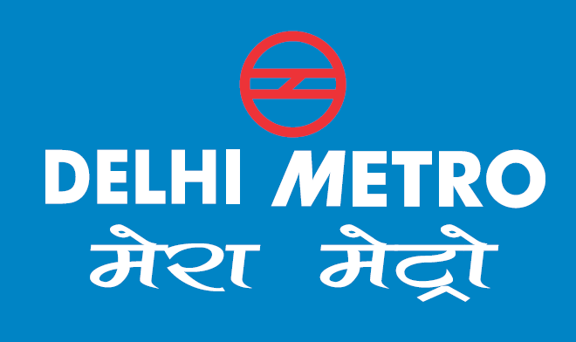

Thank You
for
Giving an opportunity
for sharing our views !!

