Slide 1

College automation system
(Cas)

Slide 2
cas
Submitted by: daljeet kaur
Shanti kumari
Roll no=11701170
Roll no=11701168
Batch-3ce5

Slide 3
content
Introduction
About the Project
Programming Language
The Problem Formulation
Solution
Database Design
Snapshots
Conclusion

Slide 4

INTODUCTION
*Presently, each and every day, a novel application or software is being introduced in the economy that serves to enhance and uplift the lifestyle of the people in innumerable ways.
*College Automation System(CAS) is an application which aims to make the work load of college staff less.
INTRODUCTION TO COLLEGE AUTOMATION SYSTEM

Slide 5
CONTINUE…
CAS is a Desktop Application.
Users have better experience with desktop application as compared to Web applications.
CAS provides basic functionality to the users (in this case teachers) to maintain the records of the students.
After login the user is redirected to the home page.
CONTINUE TO INTODUCTION….

Slide 6
ABOUT THE PROJECT
The project presented in this presentation belongs to the “Desktop Application”.
The simplest for a desktop application can be:
* It runs on a PC operating system (Windows, Mac, Linux, etc.)

Slide 7
CONTINUE….
*It has a graphical user interface.
*It does not run inside a web browser.
*An Internet connection is not required to run to this application.

Slide 8
PROGRAMMING LANGUAGE
The application is developed in Python using Tkinter framework.
This kind of application contains different forms and widgets.
A python desktop application can be deployed as exe file. An EXE file contains an executable program for Windows. EXE is short for "executable”.
INTRODUCTION TO PROGRAMMING LANGUAGE

Slide 9
THE PROBLEM FORMULATION
*Teachers have to maintain records of every student on paper which leads to huge paper work.
*Sometimes, it is hard to find record of some student through huge pile of papers.
*For marks, there is different register or papers, for attendance there is different.

Slide 10
SOLUTION
*The idea mainly focuses on making the reducing the workload of teachers by using centralized database from where every teacher has access to the records and they can add, update or remove information.
SOLUTION TO THE PROBLEM FORMULATION

Slide 11
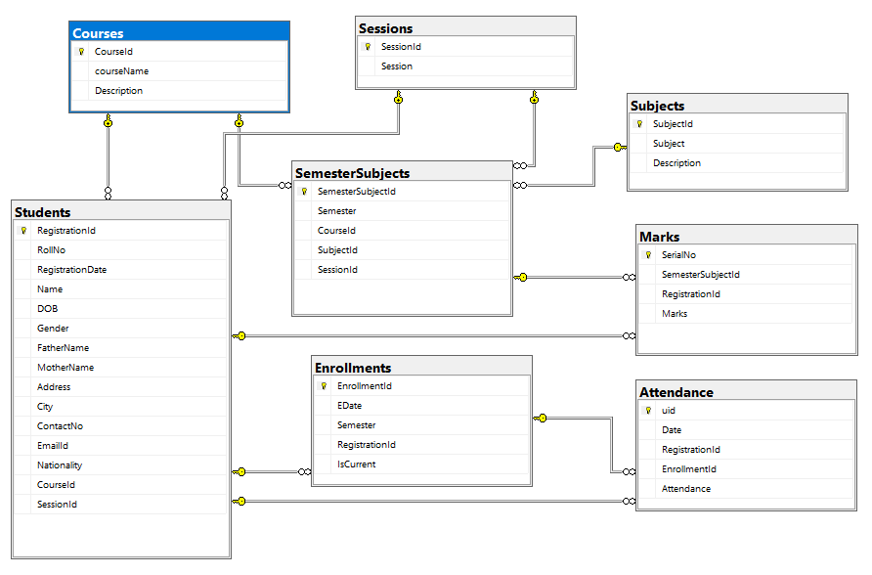
DATABASE DESIGN
DIAGRAM 1

Slide 12
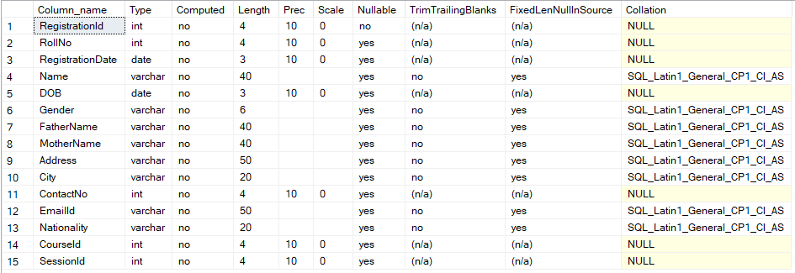
STUDENT TABLE

Slide 13
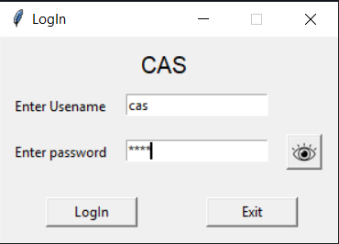
APPLICATION
INTERFACE OF APPLICATION

Slide 14
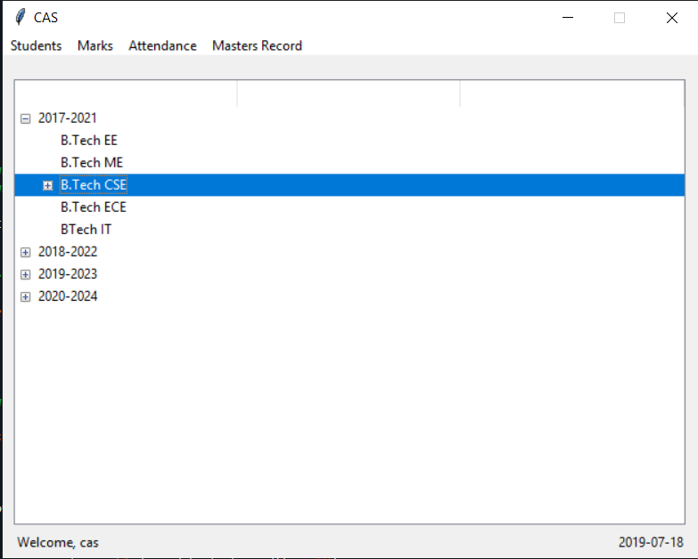
HOMEPAGE

Slide 15
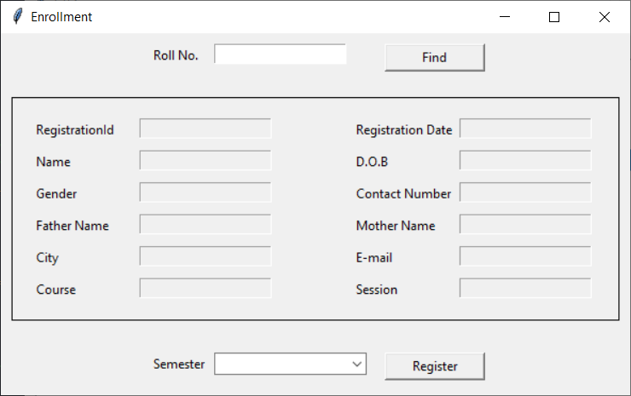
ENROLLMENT
REGISTRATION & ENROLLMENT

Slide 16
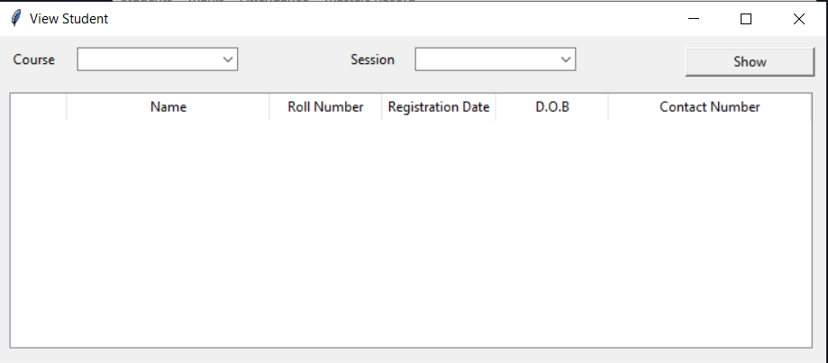
VIEW STUDENT

Slide 17
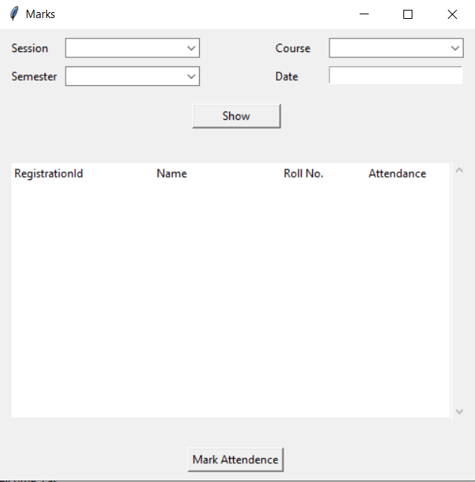
MARK ATTENDENCE

Slide 18
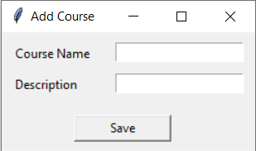
ADD COURSE

Slide 19
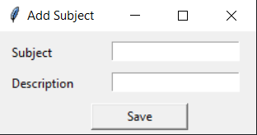
ADD
SUBJECT

Slide 20
CONCLUSION…...
I have proposed a application which can help the teachers to reduce their work load.
. If teachers are busy in dealing with records, they might not able to give time to the students.
This application will automate the things which teachers had to do manually.
They do not have to sit all day and deal with lot of papers, there work will be done in just few clicks

Slide 21

Thank You
Daljeet Kaur & Shanti Kumari

